Slide 1
4.1 Types of software and interrupts
Interrupts

Slide 2
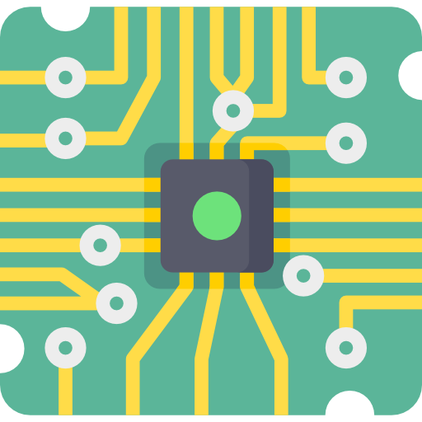
What is an interrupt?
Fetch
Decode
Execute

Slide 3




What is an interrupt?
Fetch
Decode
Execute
Keyboard
Printer
Hard disk controller
RAM

Slide 4

What is an interrupt?
Interrupt analogy
Think about it this way – when a student wants to ask a question, they raise their hand, signalling to the teacher that they need attention (i.e., generating an interrupt).

Slide 5
What is an interrupt?
Fetch
Decode
Execute
Fetch
Decode
Execute
Interrupt

Slide 6

How are interrupts handled?
Interrupts present a problem – the processor will need to stop executing the current program to run code for the interrupt, known as the interrupt service routine.
Central processing unit (CPU)
Program counter
0101
Memory address register
1001
DECODE UNIT
OPCODE OPERAND | INSTRUCTION
0000 0000 | end
0001 address | add
0010 address | subtract
0011 address | store
0101 address | load
0110 address | branch always
0111 address | branch if ACC=0
1000 address | branch if ACC>=0
1001 0001 | input
1001 0010 | output
Accumulator
Arithmetic logic unit
Memory data register
1100
Current instruction register
0100
Clock
Cache
Interrupt register
1101
Control
unit

Slide 7
How are interrupts handled?
Remember, the CPU contains registers that hold data currently being handled including:
Program counter: Memory location of the next instruction to be executed.
Current instruction register: The current instruction being executed.
Various other registers (MAR/MDR) and general-purpose registers.
Central processing unit (CPU)
Program counter
0101
Memory address register
1001
Program counter
0101
Memory address register
1001
DECODE UNIT
OPCODE OPERAND | INSTRUCTION
0000 0000 | end
0001 address | add
0010 address | subtract
0011 address | store
0101 address | load
0110 address | branch always
0111 address | branch if ACC=0
1000 address | branch if ACC>=0
1001 0001 | input
1001 0010 | output
Accumulator
Accumulator
Arithmetic logic unit
Arithmetic logic unit
Memory data register
1100
Memory data register
1100
Current instruction register
0100
Current instruction register
0100
Clock
Cache
Interrupt register
1101
Control
unit

Slide 8
How are interrupts handled?
The interrupt service routine is simply a program with a set of instructions that need to be fetched, decoded and executed to carry out the operations of the interrupt.
Central processing unit (CPU)
Program counter
1101
Program counter
0101
Memory address register
DECODE UNIT
OPCODE OPERAND | INSTRUCTION
0000 0000 | end
0001 address | add
0010 address | subtract
0011 address | store
0101 address | load
0110 address | branch always
0111 address | branch if ACC=0
1000 address | branch if ACC>=0
1001 0001 | input
1001 0010 | output
Accumulator
That means the contents of the program counter need to be changed to point to the address for the first instruction of the interrupt.
Arithmetic logic unit
Memory data register
Current instruction register
When the interrupt is complete, how will the processor know to continue the previously executing program?
Clock
Cache
Interrupt register
1101
Control
unit

Slide 9
How are interrupts handled?
When an interrupt is received, the values held in the registers are copied into a data structure in memory known as the stack.
These values are pushed onto the stack in a stack frame, effectively saving them for later retrieval.
Central processing unit (CPU)
Stack
Program counter
0101
Memory address register
1001
Program counter
0101
Memory address register
1001
DECODE UNIT
OPCODE OPERAND | INSTRUCTION
0000 0000 | end
0001 address | add
0010 address | subtract
0011 address | store
0101 address | load
0110 address | branch always
0111 address | branch if ACC=0
1000 address | branch if ACC>=0
1001 0001 | input
1001 0010 | output
Accumulator
Accumulator
Arithmetic logic unit
Memory data register
1100
Memory data register
1100
Original executing program Stack frame
Contents of registers
Current instruction register
0100
PC: 0101
CIR: 0100
MDR: 1100
MAR: 1001
…
Current instruction register
0100
Clock
Cache
Interrupt register
1101
Control
unit

Slide 10
How are interrupts handled?
The interrupt can now be executed.
Once the interrupt is complete, we pop the frame off the top of the stack – this allows us to:
Retrieve previous values for the original program.
Load them back into the processor registers.
Continue executing the program where it left off.
Central processing unit (CPU)
Stack
Program counter
Memory address register
DECODE UNIT
OPCODE OPERAND | INSTRUCTION
0000 0000 | end
0001 address | add
0010 address | subtract
0011 address | store
0101 address | load
0110 address | branch always
0111 address | branch if ACC=0
1000 address | branch if ACC>=0
1001 0001 | input
1001 0010 | output
Accumulator
Arithmetic logic unit
Memory data register
Original executing program Stack frame
Contents of registers
PC: 0101
CIR: 0100
MDR: 1100
MAR: 1001
…
Current instruction register
0100
Program counter
0101
Memory address register
1001
Current instruction register
Memory data register
1100
Clock
Cache
Interrupt register
Control
unit

Slide 11
Interrupting an interrupt
In this situation, an interrupt has come along, the previous program has been suspended and the data has been stored in a stack frame.
The interrupt is executing – let’s call it interrupt service routine A.
Central processing unit (CPU)
Stack
Program counter
0101
Memory address register
1001
Program counter
0101
Memory address register
1001
DECODE UNIT
OPCODE OPERAND | INSTRUCTION
0000 0000 | end
0001 address | add
0010 address | subtract
0011 address | store
0101 address | load
0110 address | branch always
0111 address | branch if ACC=0
1000 address | branch if ACC>=0
1001 0001 | input
1001 0010 | output
Accumulator
Accumulator
Arithmetic logic unit
Memory data register
1100
Memory data register
1100
Original executing program Stack frame
Contents of registers
Current instruction register
0100
PC: 0101
CIR: 0100
MDR: 1100
MAR: 1001
…
Current instruction register
0100
Clock
Cache
Interrupt register
1101
Interrupt register
1101
Control
unit

Slide 12
Interrupting an interrupt
While the processor executes ISR A, another higher-priority interrupt comes along.
The stack system handles this perfectly – it simply:
Suspends ISR A.
Pushes register contents onto the top of the stack.
Starts executing ISR B.
Central processing unit (CPU)
Stack
Program counter
0011
Memory address register
1011
Program counter
0101
Memory address register
1001
Interrupt service routine A Stack frame
DECODE UNIT
OPCODE OPERAND | INSTRUCTION
0000 0000 | end
0001 address | add
0010 address | subtract
0011 address | store
0101 address | load
0110 address | branch always
0111 address | branch if ACC=0
1000 address | branch if ACC>=0
1001 0001 | input
1001 0010 | output
Accumulator
Accumulator
Contents of registers
PC: 0011
CIR: 1001
MDR: 1110
MAR: 1011
…
Arithmetic logic unit
Memory data register
1100
Memory data register
1110
Original executing program Stack frame
Contents of registers
Current instruction register
0100
PC: 0101
CIR: 0100
MDR: 1100
MAR: 1001
…
Current instruction register
1001
Clock
Cache
Interrupt register
1111
Interrupt register
1111
Control
unit

Slide 13
Interrupting an interrupt
Once ISR B has completed executing, we pop the frame off the top of the stack – in doing so, we:
Retrieve values for ISR A.
Load them back into the processor registers.
Carry on executing ISR A.
Central processing unit (CPU)
Stack
Program counter
0110
Memory address register
0001
Interrupt service routine A Stack frame
DECODE UNIT
OPCODE OPERAND | INSTRUCTION
0000 0000 | end
0001 address | add
0010 address | subtract
0011 address | store
0101 address | load
0110 address | branch always
0111 address | branch if ACC=0
1000 address | branch if ACC>=0
1001 0001 | input
1001 0010 | output
Accumulator
Accumulator
Contents of registers
PC: 0011
CIR: 1001
MDR: 1110
MAR: 1011
…
Memory data register
1110
Memory address register
1011
Current instruction register
1001
Program counter
0011
Arithmetic logic unit
Memory data register
0011
Original executing program Stack frame
Contents of registers
Current instruction register
1000
PC: 0101
CIR: 0100
MDR: 1100
MAR: 1001
…
Clock
Cache
Interrupt register
Control
unit

Slide 14
Interrupting an interrupt
Once ISR A has completed executing, we pop the frame off the top of the stack – in doing so, we:
Retrieve previous values for the original program.
Load them back into the processor registers.
Carry on executing the program where it left off.
Central processing unit (CPU)
Stack
Program counter
0110
Memory address register
0001
DECODE UNIT
OPCODE OPERAND | INSTRUCTION
0000 0000 | end
0001 address | add
0010 address | subtract
0011 address | store
0101 address | load
0110 address | branch always
0111 address | branch if ACC=0
1000 address | branch if ACC>=0
1001 0001 | input
1001 0010 | output
Accumulator
Accumulator
Arithmetic logic unit
Memory data register
0011
Original executing program Stack frame
Contents of registers
PC: 0101
CIR: 0100
MDR: 1100
MAR: 1001
…
Current instruction register
0100
Program counter
0101
Memory data register
1100
Current instruction register
1000
Memory address register
1001
Clock
Cache
Interrupt register
Control
unit

Slide 15

The importance of interrupt priorities
Interrupt service routine priorities are important
Interrupts always have a higher priority than normal programs

Slide 16
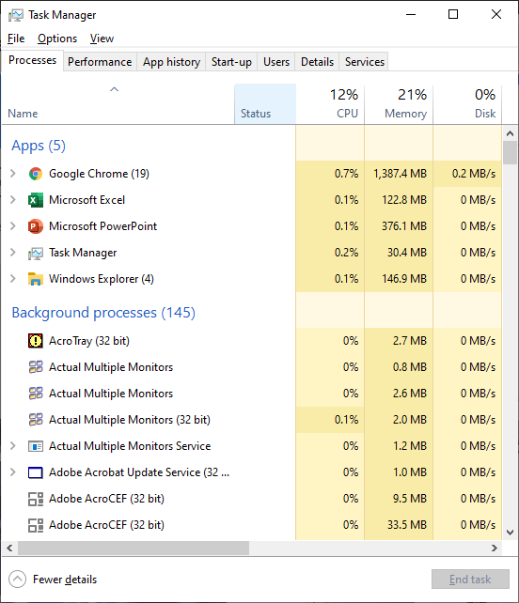
The importance of interrupt priorities
Say your computer stops responding and you want to open the task manager or shut your PC down.
The processor is caught in a situation it can’t resolve. If we cannot interrupt the cycle by pressing Ctrl + Alt + Del or the power button, the only way to recover the situation is by pulling the plug.

Slide 17
Interrupt priorities
Interrupt | Examples
Hardware | Power supply failure. Power/reset button pressed. Power-down command (screen off, hibernate).
User | Moving the mouse. Clicking/tapping an icon to open a new program. Keyboard presses.
Software | Illegal instruction encountered. Arithmetic overflow. New login request.
Timer | Data-logging program reading an input sensor every second. Screen recording application.
Input/output devices | Buffer nearly empty. Signal the completion of a data transfer to/from a device. Printer ink supply notification.

Slide 18

Interrupts
An interrupt is a request for the processor’s attention. Interrupts can be generated by either software or hardware.
Software interrupts include division-by-zero and two processes trying to access the same memory location.
Hardware interrupts include pressing a key on the keyboard and moving the mouse.
Interrupts are placed into an interrupt register. The interrupt register is checked after each fetch-decode-execute cycle.
If an interrupt is detected and is higher priority that what is currently being executed, then control is passed to the interrupt service routine.
The current contents of the registers are stored away so the program being interrupted can be resumed later.

Slide 19


